Slide 1
Discrete Mathematics and Its Application 7th edition, 2001
Kenneth H. Rosen

Slide 2
Welcome to Discrete Mathematics Spring 2018
Instructor: Niu Shao Zhang

Slide 3
§5.3 Recursive Definitions and Structural Induction递归定义和结构归纳法
Section Summary
Recursively Defined Functions
Recursively Defined Sets and Structures
Structural Induction
Generalized Induction

Slide 4
Recursively Defined Functions 递归地定义函数
Definition: A recursive or inductive definition of a function consists of two steps.
BASIS STEP: Specify the value of the function at zero.
RECURSIVE STEP: Give a rule for finding its value at an integer from its values at smaller integers.

Slide 5
Recursively Defined Functions
A function f(n) is the same as a sequence a₀, a₁, … , where a_{i}, where f(i) = a_{i}. This was done using recurrence relations（递推关系） in Section 2.4.
Example: Give a recursive definition of the factorial function n!:
Solution:
f(0) = 1
f(n + 1) = (n + 1)∙ f(n)

Slide 6
Recursively Defined Functions
Example: Suppose f is defined by:
f(0) = 3,
f(n + 1) = 2f(n) + 3
Find f(1), f(2), f(3), f(4)
Solution:
f(1) = 2f(0) + 3 = 2∙3 + 3 = 9
f(2) = 2f(1)+ 3 = 2∙9 + 3 = 21
f(3) = 2f(2) + 3 = 2∙21 + 3 = 45
f(4) = 2f(3) + 3 = 2∙45 + 3 = 93

Slide 7
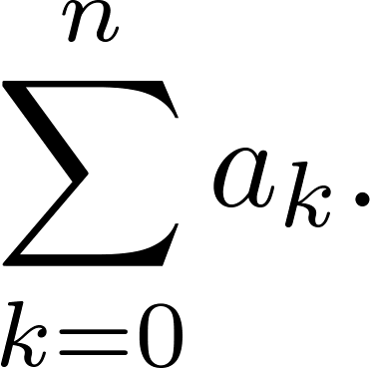
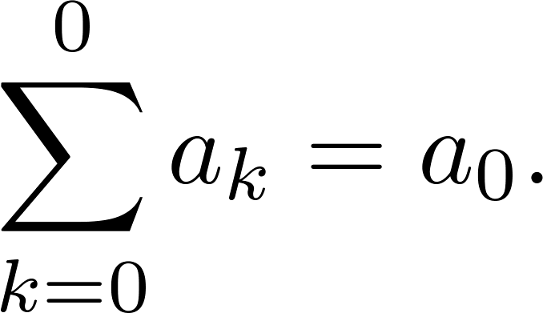
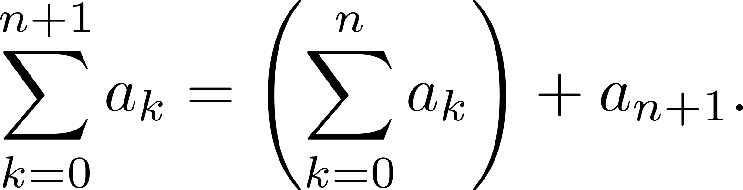
Recursively Defined Functions
Example: Give a recursive definition of:
Solution: The first part of the definition is
The second part is

Slide 8
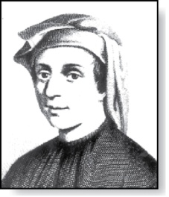
Fibonacci Numbers
Fibonacci
(1170- 1250)
Example : The Fibonacci numbers are defined as follows:
f₀ = 0
f₁ = 1
f_{n} = f_{n−1} + f_{n−2}
Find f₂, f₃ , f₄ , f₅ .
f₂ = f₁ + f₀ = 1 + 0 = 1
f₃ = f₂ + f₁ = 1 + 1 = 2
f₄ = f₃ + f₂ = 2 + 1 = 3
f₅ = f₄ + f₃ = 3 + 2 = 5
In Chapter 8, we will use the Fibonacci numbers to model population growth of rabbits. This was an application described by Fibonacci himself.
Next, we use strong induction to prove a result about the Fibonacci numbers.

Slide 9
Fibonacci Numbers
Example 4: Show that whenever n ≥ 3, f_{n} > α^{n − 2}, where α = (1 + √5)/2.
Solution: Let P(n) be the statement f_{n} > α^{n−2} . Use strong induction to show that P(n) is true whenever n ≥ 3.
BASIS STEP: P(3) holds since α < 2 = f₃
P(4) holds since α² = (3 + √5)/2 < 3 = f₄ .
INDUCTIVE STEP: Assume that P(j) holds, i.e., f_{j} > α^{j−2} for all integers j with
3 ≤ j ≤ k, where k ≥ 4. Show that P(k + 1) holds, i.e., f_{k+1} > α^{k−1} .
Since α² = α + 1 (because α is a solution of x² − x − 1 = 0),
By the inductive hypothesis, because k ≥ 4 we have
Therefore, it follows that
Hence, P(k + 1) is true.
f_{k−1} > α^{k−3}, f_{k−1} > α^{k−2}.
Why does this equality hold?
f_{k+1} = f_{k+1} + f_{k−1} > α^{k−2} + α^{k−3} = α^{k−1}.
α^{k−1} = α² ∙ α^{k−3} = ( α + 1) ∙α^{k−3} = α ∙α^{k−3}+ 1 ∙α^{k−3} = α^{k−2} + α^{k−3}

Slide 10
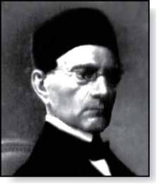
Lamé’s Theorem 拉梅定理
Gabriel Lamé
(1795-1870)
Lamé’s Theorem: Let a and b be positive integers with a ≥ b. Then the number of divisions used by the Euclidian algorithm to find gcd(a,b) is less than or equal to five times the number of decimal digits in b.
Proof: When we use the Euclidian algorithm to find gcd(a,b) with a ≥ b,
n divisions are used to obtain (with a = r₀,b =r₁ ):
Since each quotient q₁, q₂ , …,q_{n-1} is at least 1 and q_{n} ≥ 2:
r_{n} ≥ 1 = f₂,
r_{n-1} ≥ 2 r_{n} ≥ 2 f₂ = f₃,
r_{n-2} ≥ r_{n-1} + r_{n} ≥ f₃ + f₂ = f₄,
⋮
r₂ ≥ r₃ + r₄ ≥ f_{n-1} + f_{n-2} = f_{n},
b = r₁ ≥ r₂ + r₃ ≥ f_{n} + f_{n-1} = f_{n+1}.
r₀ = r₁q₁ + r₂ 0 ≤ r₂ < r₁,
r₁ = r₂q₂ + r₃ 0 ≤ r₃ < r₂,
⋮
r_{n-2} = r_{n-1}q_{n-1} + r_{n} 0 ≤ r_{n} < r_{n-1},
r_{n-1} = r_{n}q_{n}.
continued →

Slide 11
Lamé’s Theorem
It follows that if n divisions are used by the Euclidian algorithm to find gcd(a,b) with a ≥ b, then b ≥ f_{n+1}. By Example 4, f_{n+1} > α^{n − 1}, for n > 2, where α = (1 + √5)/2.
Therefore, b > α^{n−1}.
Because log₁₀ α ≈ 0.208 > 1/5, log₁₀ b > (n−1) log₁₀ α > (n−1)/5 . Hence,
Suppose that b has k decimal digits. Then b < 10^{k} and log₁₀ b < k. It follows that n − 1 < 5k and since k is an integer, n ≤ 5k.
As a consequence of Lamé’s Theorem, O(log b) divisions are used by the Euclidian algorithm to find gcd(a,b) whenever a > b.
By Lamé’s Theorem, the number of divisions needed to find gcd(a,b) with a > b is less than or equal to 5 (log₁₀ b + 1) since the number of decimal digits in b (which equals ⌊log₁₀ b⌋ + 1) is less than or equal to log₁₀ b + 1.
n−1 < 5 ∙log₁₀ b.
Lamé’s Theorem was the first result in computational complexity

Slide 12
Recursively Defined Sets and Structures
Recursive definitions of sets have two parts:
The basis step specifies an initial collection of elements.（基础步骤规定一些初始元素）
The recursive step gives the rules for forming new elements in the set from those already known to be in the set. （归纳步骤给出从集合元素来构造集合新元素的规则）

Slide 13
Recursively Defined Sets and Structures
Sometimes the recursive definition has an exclusion rule, which specifies that the set contains nothing other than those elements specified in the basis step and generated by applications of the rules in the recursive step. （有时递归定义包含排斥规则）
We will always assume that the exclusion rule holds, even if it is not explicitly mentioned. （默认排斥规则成立）

Slide 14
Recursively Defined Sets and Structures
Example : Subset of Integers S:
BASIS STEP: 3 ∊ S.
RECURSIVE STEP: If x ∊ S and y ∊ S, then x + y is in S.
Initially 3 is in S, then 3 + 3 = 6, then 3 + 6 = 9, etc.
（归纳定义了S是由3的正整数倍数的集合）

Slide 15
Recursively Defined Sets and Structures
Example: The natural numbers N.
BASIS STEP: 0 ∊ N.
RECURSIVE STEP: If n is in N, then n + 1 is in N.
Initially 0 is in S, then 0 + 1 = 1, then 1 + 1 = 2, etc.

Slide 16
Strings
Definition: The set Σ* of strings over the alphabet Σ:
BASIS STEP: λ ∊ Σ* (λ is the empty string)
RECURSIVE STEP: If w is in Σ* and x is in Σ, then wx ∈ Σ*.
Example: If Σ = {0,1}, the strings in in Σ* are the set of all bit strings, λ,0,1, 00,01,10, 11, etc.

Slide 17
Strings
Example: If Σ = {a,b}, show that aab is in Σ*.
Since λ ∊ Σ* and a ∊ Σ, a ∊ Σ*.
Since a ∊ Σ* and a ∊ Σ, aa ∊ Σ*.
Since aa ∊ Σ* and b ∊ Σ, aab ∊ Σ*.

Slide 18
String Concatenation（串的连接）
Definition: Two strings can be combined via the operation of concatenation. Let Σ be a set of symbols and Σ* be the set of strings formed from the symbols in Σ. We can define the concatenation of two strings, denoted by ∙, recursively as follows.
BASIS STEP: If w ∈ Σ*, then w ∙ λ= w.
RECURSIVE STEP: If w₁ ∈ Σ* and w₂ ∈ Σ* and x ∈ Σ, then w₁ ∙ (w₂ x)= (w₁ ∙ w₂)x.
Often w₁ ∙ w₂ is written as w₁ w₂.
If w₁ = abra and w₂ = cadabra, the concatenation w₁ w₂ = abracadabra.

Slide 19
Length of a String
Example: Give a recursive definition of l(w), the length of the string w.
Solution: The length of a string can be recursively defined by:
l(λ) = 0;
l(wx) = l(w) + 1 if w ∊ Σ* and x ∊ Σ.

Slide 20
Balanced Parentheses （平衡圆括号）
Example: Give a recursive definition of the set of balanced parentheses P.
Solution:
BASIS STEP: () ∊ P
RECURSIVE STEP: If w ∊ P, then () w ∊ P, (w) ∊ P and w () ∊ P.
Show that (() ()) is in P.
Why is ))(() not in P?

Slide 21
Well-Formed Formulae in Propositional Logic（命题逻辑中的合式公式）
Definition: The set of well-formed formulae in propositional logic involving T, F, propositional variables, and operators from the set {¬,∧,∨,→,↔}.
BASIS STEP: T,F, and s, where s is a propositional variable, are well-formed formulae.
RECURSIVE STEP: If E and F are well formed formulae, then (¬ E), (E ∧ F), (E ∨ F), (E → F), (E ↔ F), are well-formed formulae.
Examples: ((p ∨q) → (q ∧ F)) is a well-formed formula.
pq ∧ is not a well formed formula.

Slide 22
Rooted Trees（根数）
Definition: The set of rooted trees, where a rooted tree consists of a set of vertices containing a distinguished vertex called the root, and edges connecting these vertices, can be defined recursively by these steps:
BASIS STEP: A single vertex r is a rooted tree.
RECURSIVE STEP: Suppose that T₁, T₂, …,T_{n} are disjoint rooted trees with roots r₁, r₂,…,r_{n}, respectively. Then the graph formed by starting with a root r, which is not in any of the rooted trees T₁, T₂, …,T_{n}, and adding an edge from r to each of the vertices r₁, r₂,…,r_{n}, is also a rooted tree.

Slide 23
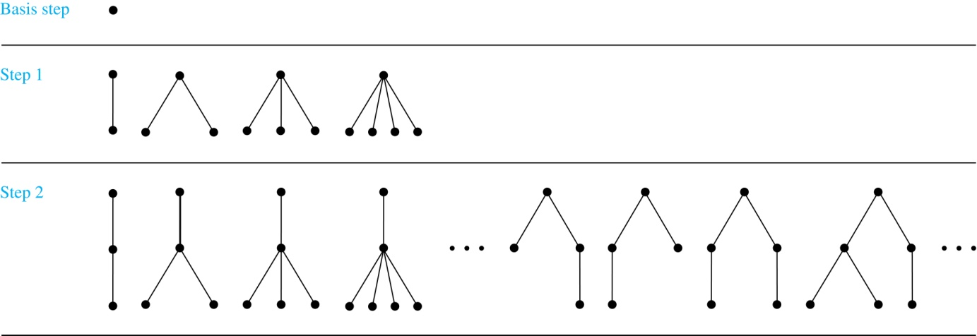
Building Up Rooted Trees （建立根数）
Trees are studied extensively in Chapter 11.
Next we look at a special type of tree, the full binary tree.

Slide 24
Full Binary Trees（满二叉树）
Definition: The set of full binary trees can be defined recursively by these steps.
BASIS STEP: There is a full binary tree consisting of only a single vertex r.
RECURSIVE STEP: If T₁ and T₂ are disjoint full binary trees, there is a full binary tree, denoted by T₁∙T₂, consisting of a root r together with edges connecting the root to each of the roots of the left subtree T₁ and the right subtree T₂.

Slide 25
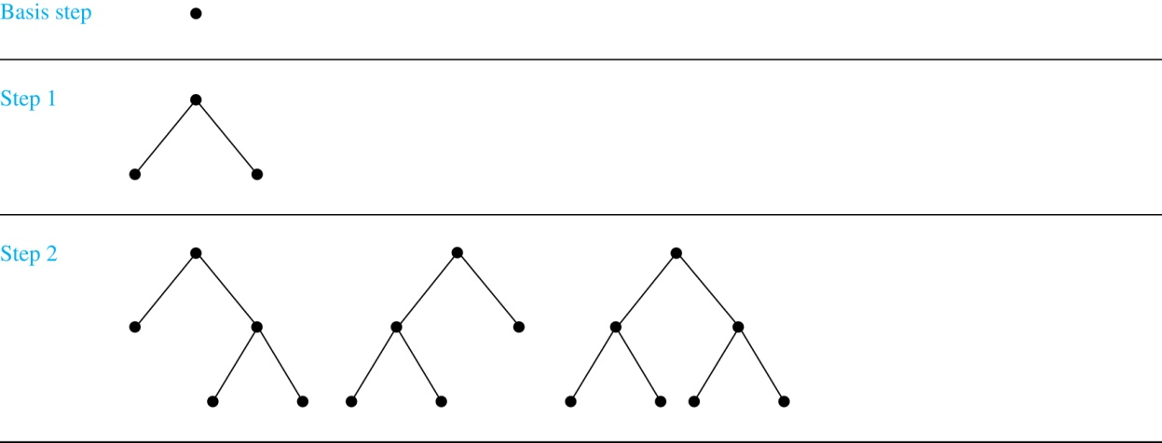
Building Up Full Binary Trees

Slide 26
Induction and Recursively Defined Sets
Example: Show that the set S defined by specifying that 3 ∊ S and that if x ∊ S and y ∊ S, then x + y is in S, is the set of all positive integers that are multiples of 3.
Solution: Let A be the set of all positive integers divisible by 3. To prove that A = S, show that A is a subset of S and S is a subset of A.
A⊂ S: Let P(n) be the statement that 3n belongs to S.
BASIS STEP: 3∙1 = 3 ∊ S, by the first part of recursive definition.
INDUCTIVE STEP: Assume P(k) is true. By the second part of the recursive definition, if 3k ∊ S, then since 3 ∊ S, 3k + 3 = 3(k + 1) ∊ S. Hence, P(k + 1) is true.
S ⊂ A:
BASIS STEP: 3 ∊ S by the first part of recursive definition, and 3 = 3∙1.
INDUCTIVE STEP: The second part of the recursive definition adds x +y to S, if both x and y are in S. If x and y are both in A, then both x and y are divisible by 3. By part (i) of Theorem 1 of Section 4.1, it follows that x + y is divisible by 3.
We used mathematical induction to prove a result about a recursively defined set. Next we study a more direct form induction for proving results about recursively defined sets.
我们使用数学归纳法来证明归纳定义的集合，下面，我们学习更直接的证明形式——结构归纳法。

Slide 27
Structural Induction
Definition: To prove a property of the elements of a recursively defined set, we use structural induction.
BASIS STEP: Show that the result holds for all elements specified in the basis step of the recursive definition.（证明对于归纳定义的基础步骤中规定的元素成立）
RECURSIVE STEP: Show that if the statement is true for each of the elements used to construct new elements in the recursive step of the definition, the result holds for these new elements. （证明对于归纳步骤中的新元素来说，命题成立）
The validity of structural induction can be shown to follow from the principle of mathematical induction.

Slide 28
Full Binary Trees
Definition: The height h(T) of a full binary tree T is defined recursively as follows:
BASIS STEP: The height of a full binary tree T consisting of only a root r is h(T) = 0.
RECURSIVE STEP: If T₁ and T₂ are full binary trees, then the full binary tree T = T₁∙T₂ has height
h(T) = 1 + max(h(T₁),h(T₂)).

Slide 29
Full Binary Trees
The number of vertices n(T) of a full binary tree T satisfies the following recursive formula:
BASIS STEP: The number of vertices of a full binary tree T consisting of only a root r is n(T) = 1.
RECURSIVE STEP: If T₁ and T₂ are full binary trees, then the full binary tree T = T₁∙T₂ has the number of vertices n(T) = 1 + n(T₁) + n(T₂).

Slide 30
Structural Induction and Binary Trees
Theorem: If T is a full binary tree, then n(T) ≤ 2^{h(T)+1} – 1.
Proof: Use structural induction.
BASIS STEP: The result holds for a full binary tree consisting only of a root, n(T) = 1 and h(T) = 0. Hence, n(T) = 1 ≤ 2⁰⁺¹ – 1 = 1.
RECURSIVE STEP: Assume n(T₁) ≤ 2^{h(T1)+1} – 1 and also n(T₂) ≤ 2^{h(T2)+1} – 1 whenever T₁ and T₂ are full binary trees.
n(T) = 1 + n(T₁) + n(T₂) (by recursive formula of n(T))
≤ 1 + (2^{h(T1)+1} – 1) + (2^{h(T2)+1} – 1) (by inductive hypothesis)
≤ 2∙max(2^{h(T1)+1} ,2^{h(T2)+1} ) – 1
= 2∙2^{max(h(T1),h(T2))+1} – 1 (max(2^{x} , 2^{y})= 2^{max(x,y)} )
= 2∙2^{h(t)} – 1 (by recursive definition of h(T))
= 2^{h(t)+1} – 1

Slide 31
Generalized Induction
Generalized induction is used to prove results about sets other than the integers that have the well-ordering property. (广义归纳法用来证明其他具有良序性的集合上的结果)
For example, consider an ordering on N⨉ N, ordered pairs of nonnegative integers. Specify that (x₁ ,y₁) is less than or equal to (x₂,y₂) if either x₁ < x₂, or x₁ = x₂ and y₁ <y₂ . This is called the lexicographic ordering.（字典顺序）

Slide 32
Generalized Induction
Strings are also commonly ordered by a lexicographic ordering.（字符串具有字典顺序）
The next example uses generalized induction to prove a result about ordered pairs from N⨉ N. （有序对具有字典顺序）

Slide 33
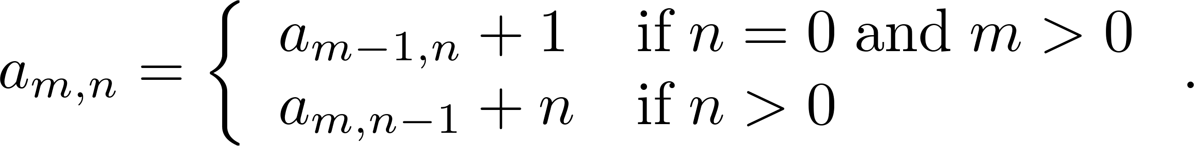
Generalized Induction
Example: Suppose that a_{m,n} is defined for (m,n)∊N ×N by a_{0,0} = 0 and
Show that a_{m,n} = m + n(n + 1)/2 is defined for all (m,n)∊N ×N.
Solution: Use generalized induction.
BASIS STEP: a_{0,0} = 0 = 0 + (0∙1)/2
INDUCTIVE STEP: Assume that a_{m̍,n̍} = m̍+ n̍(n̍ + 1)/2 whenever(m̍,n̍) is less than (m,n) in the lexicographic ordering of N ×N .
If n = 0, by the inductive hypothesis we can conclude
a_{m,n} = a_{m−1,n} + 1 = m − 1+ n(n + 1)/2 + 1 = m + n(n + 1)/2 .
If n > 0, by the inductive hypothesis we can conclude
a_{m,n} = a_{m−1,n} + 1 = m + n(n − 1)/2 +n = m + n(n + 1)/2 .

Slide 34
Homework
§5.3
20, 38, 48

